Slide 1
Summary 2025
Collectors | State | Hosts | Amounts | Isolation | DNA/PCR (+)
Bily Devin | VA | Grapes (5), oaks (11), yellowwood (1), elm (1) | 18 | NA | 11/11
Boris | VA | Unknown, oleander, grape, black cherry, Iris | 5 | NA | 1/1
Eric Case | SC | Grapevine/Chambourcino (1) | 1 | NA | 1/To be done
Sarah Lower | GA | Grapes (12), plum (1) | 13 | NA | 13/To be done
Chunxian Chen | GA | Plum (4/4), peach (4/4) | 16 | NA | 16/To be done
Fulya Baysal-Gurel | TN | Red Oaks | 2 | NA | 2/To be done
Jill Pollok | DE | Oaks | 7 | NA | 7/To be done
Mark McClanahan | NC | Oak | 1 | NA | 1/To be done
Mack Jolinson | NC | Sycamore | 1 | On going | To be done
Jingjing Yang | VA | Unknown (3), blueberry (3), muscadine(2), grapes (39), peach (1),oaks (6) | 62 | 5 isolates | 62/To be done
Total (amount) | 6 | Ca. 15 | 126 | 3 | 122/12

Slide 2
Successful isolations
Collector | Vineyards | Variety | BCYE | PWG | DNA
Jingjing Yang | Chatham Vineyards | Chardonnay Dijon | + | + | To be done
 |  | Merlot | + | + | To be done
 |  | Chardonnay | NA | + | To be done
 | Upper Shirley Vineyards | Cabernet Sauvignon | NA | + | To be done
 |  | Cabernet Sauvignon | + | + | 3 subcultures
Total | 2 | 4 | 3 | 5

Slide 3
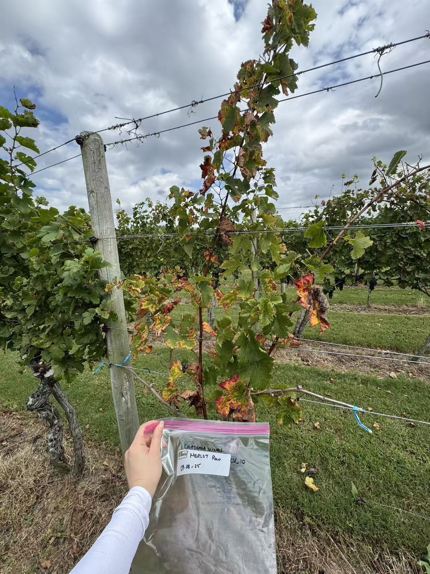
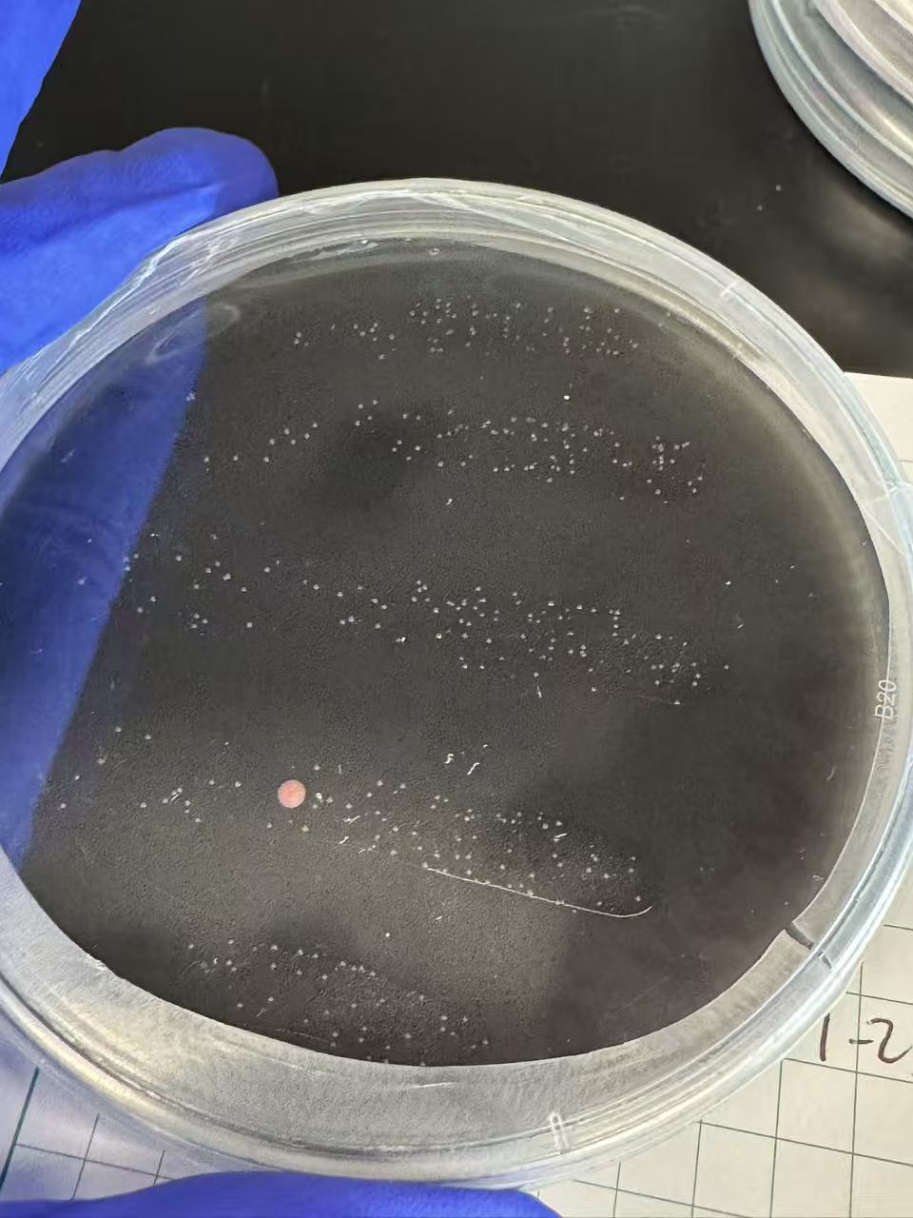
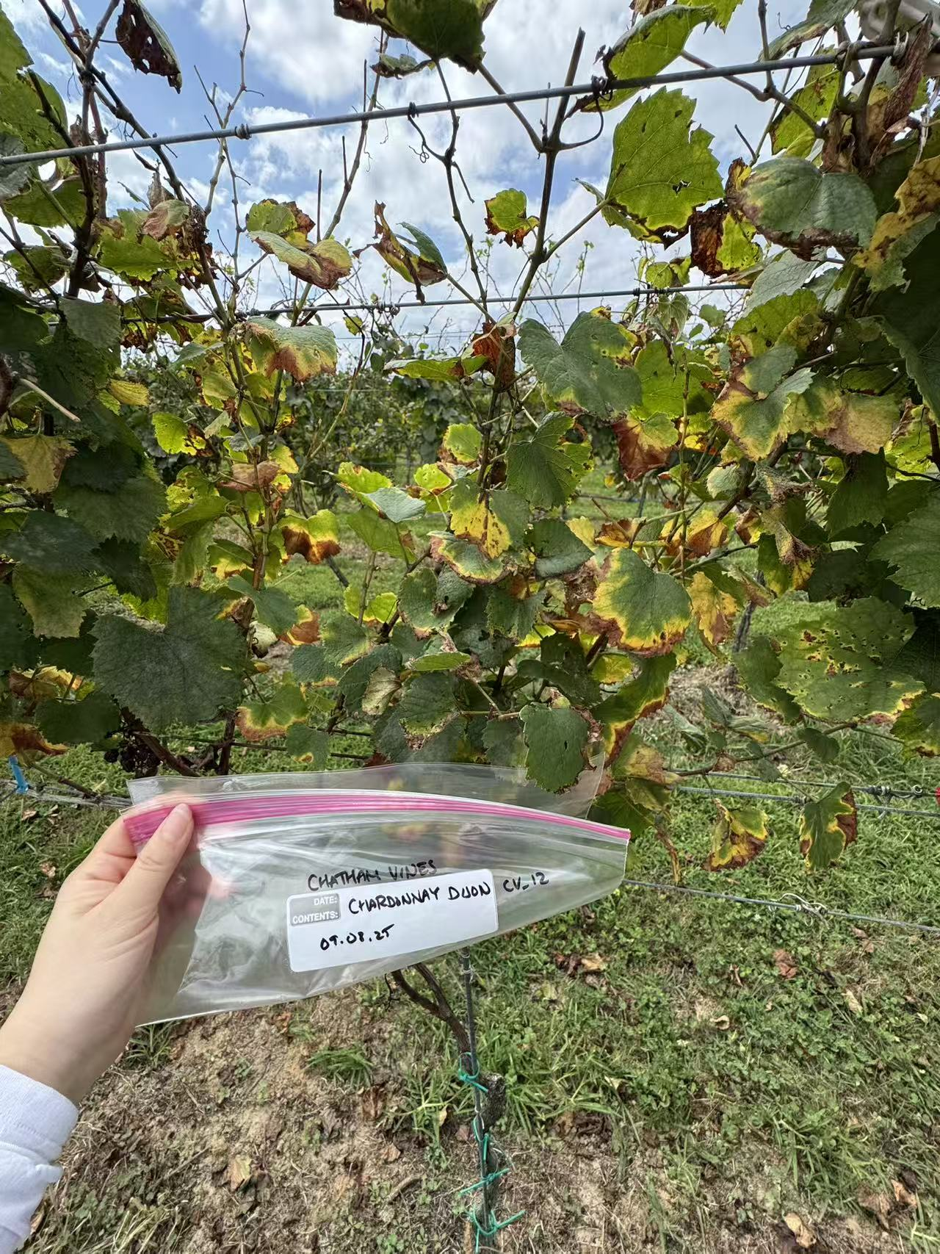
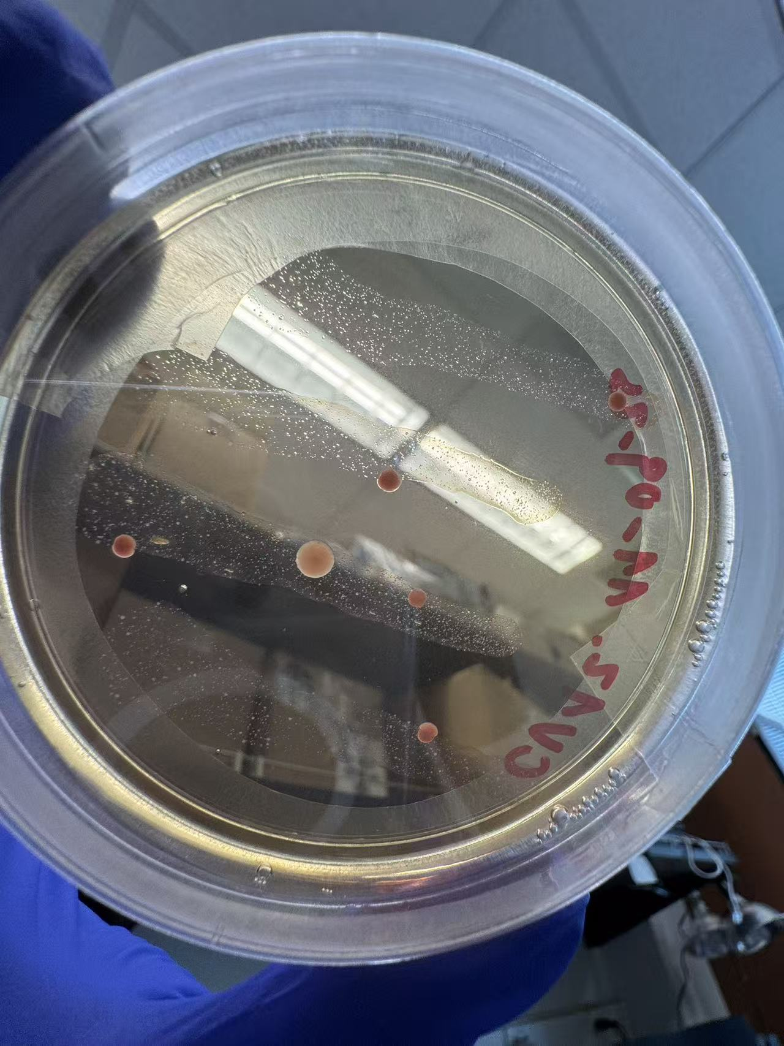
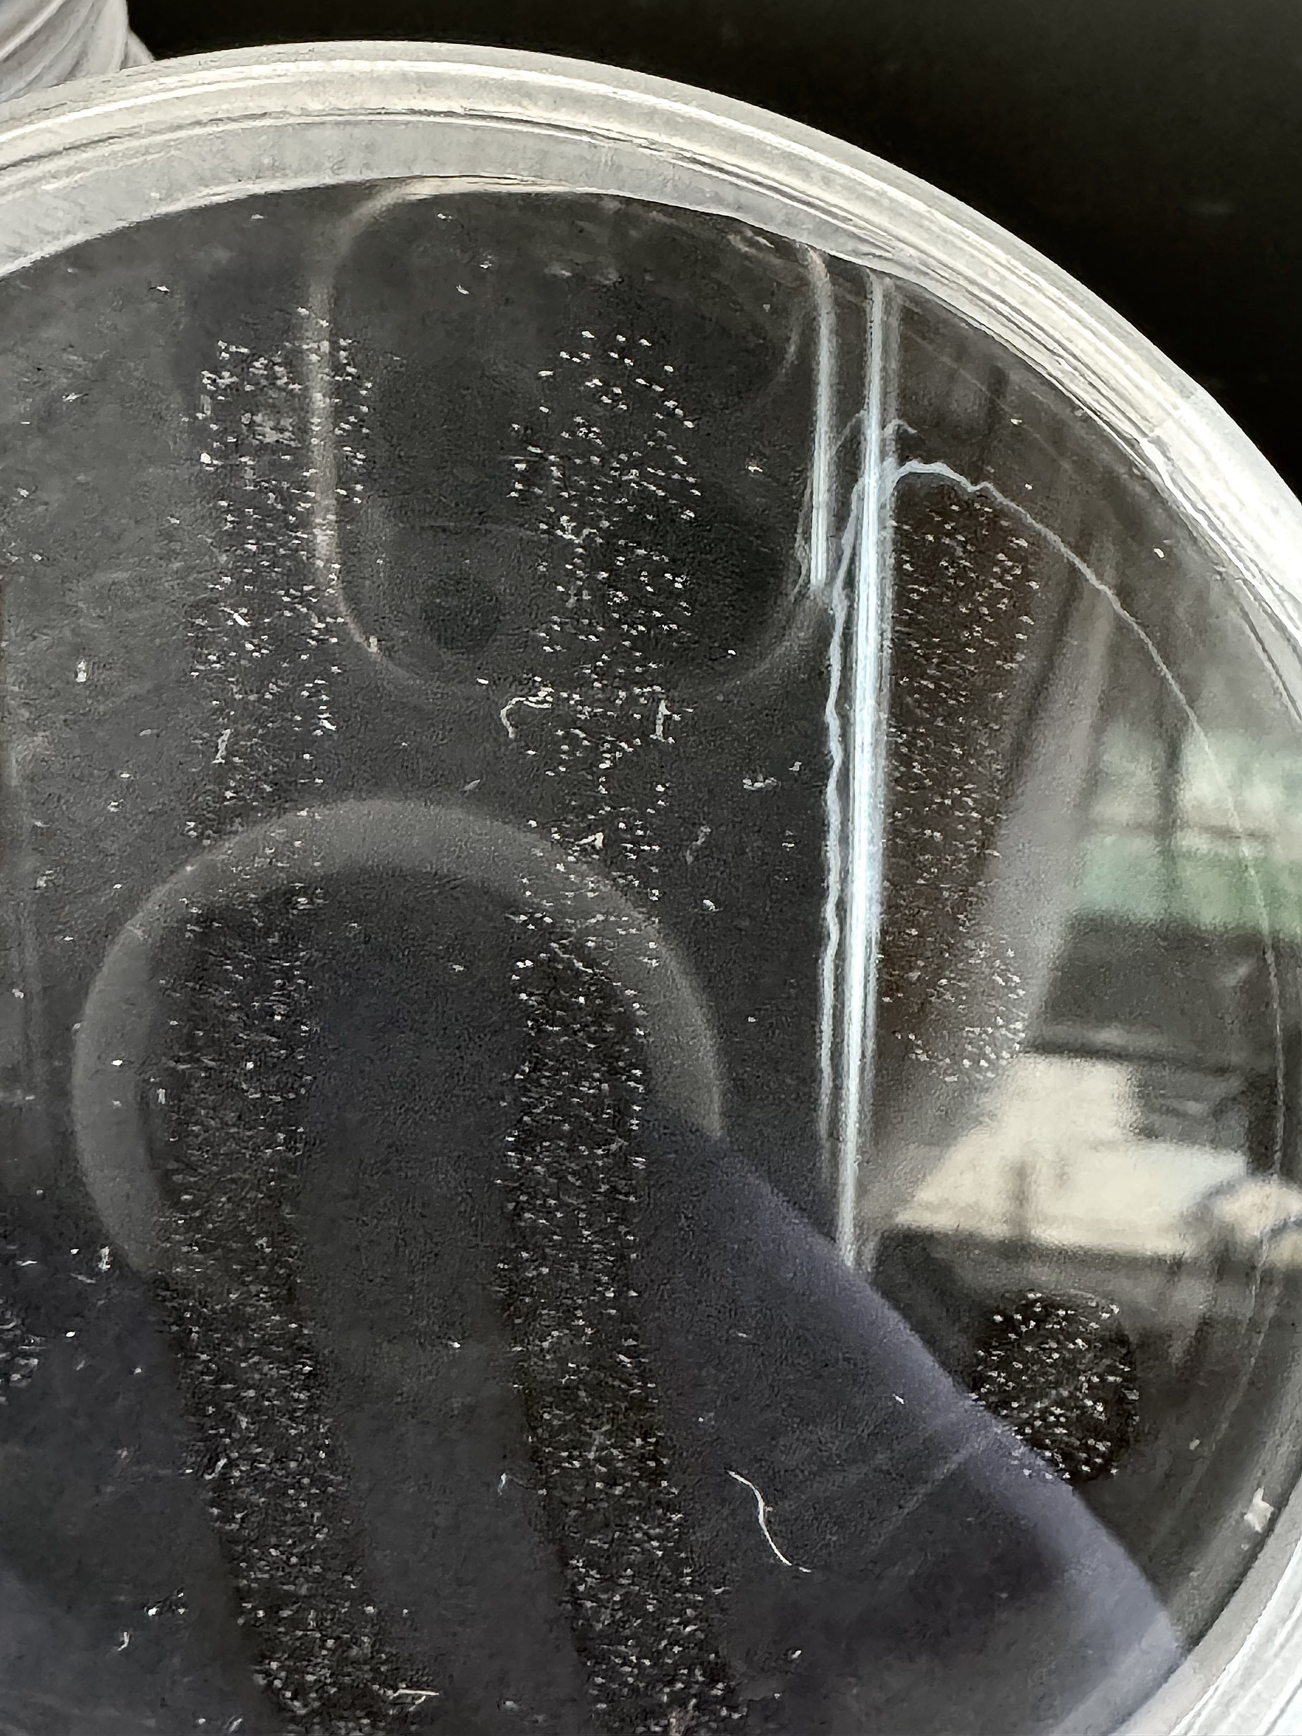
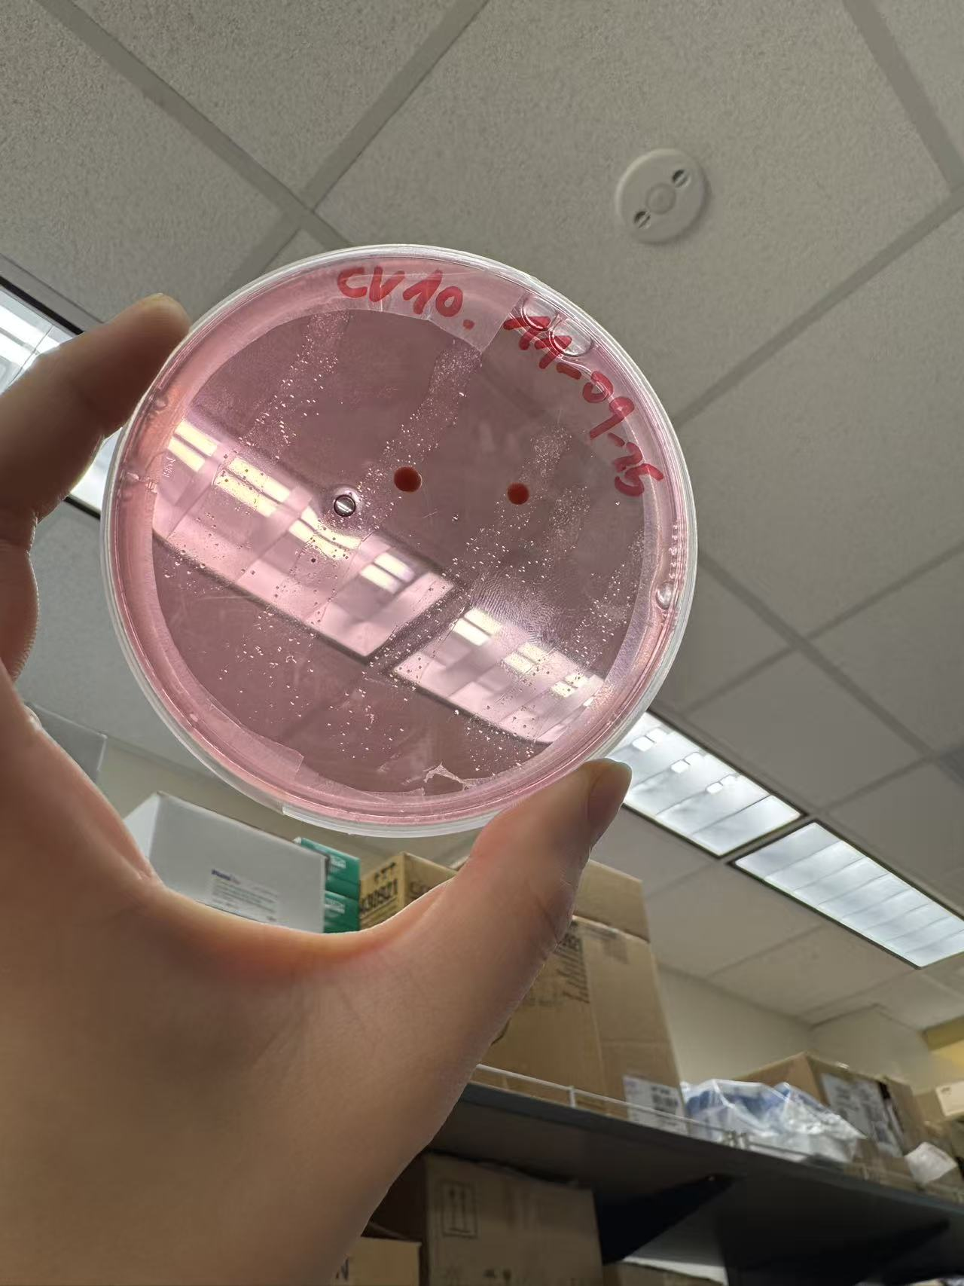
Isolated samples (Chatham Vineyards)
PWG
BCYE
BCYE
Chardonnay Dijon
PWG
Merlot

Slide 4
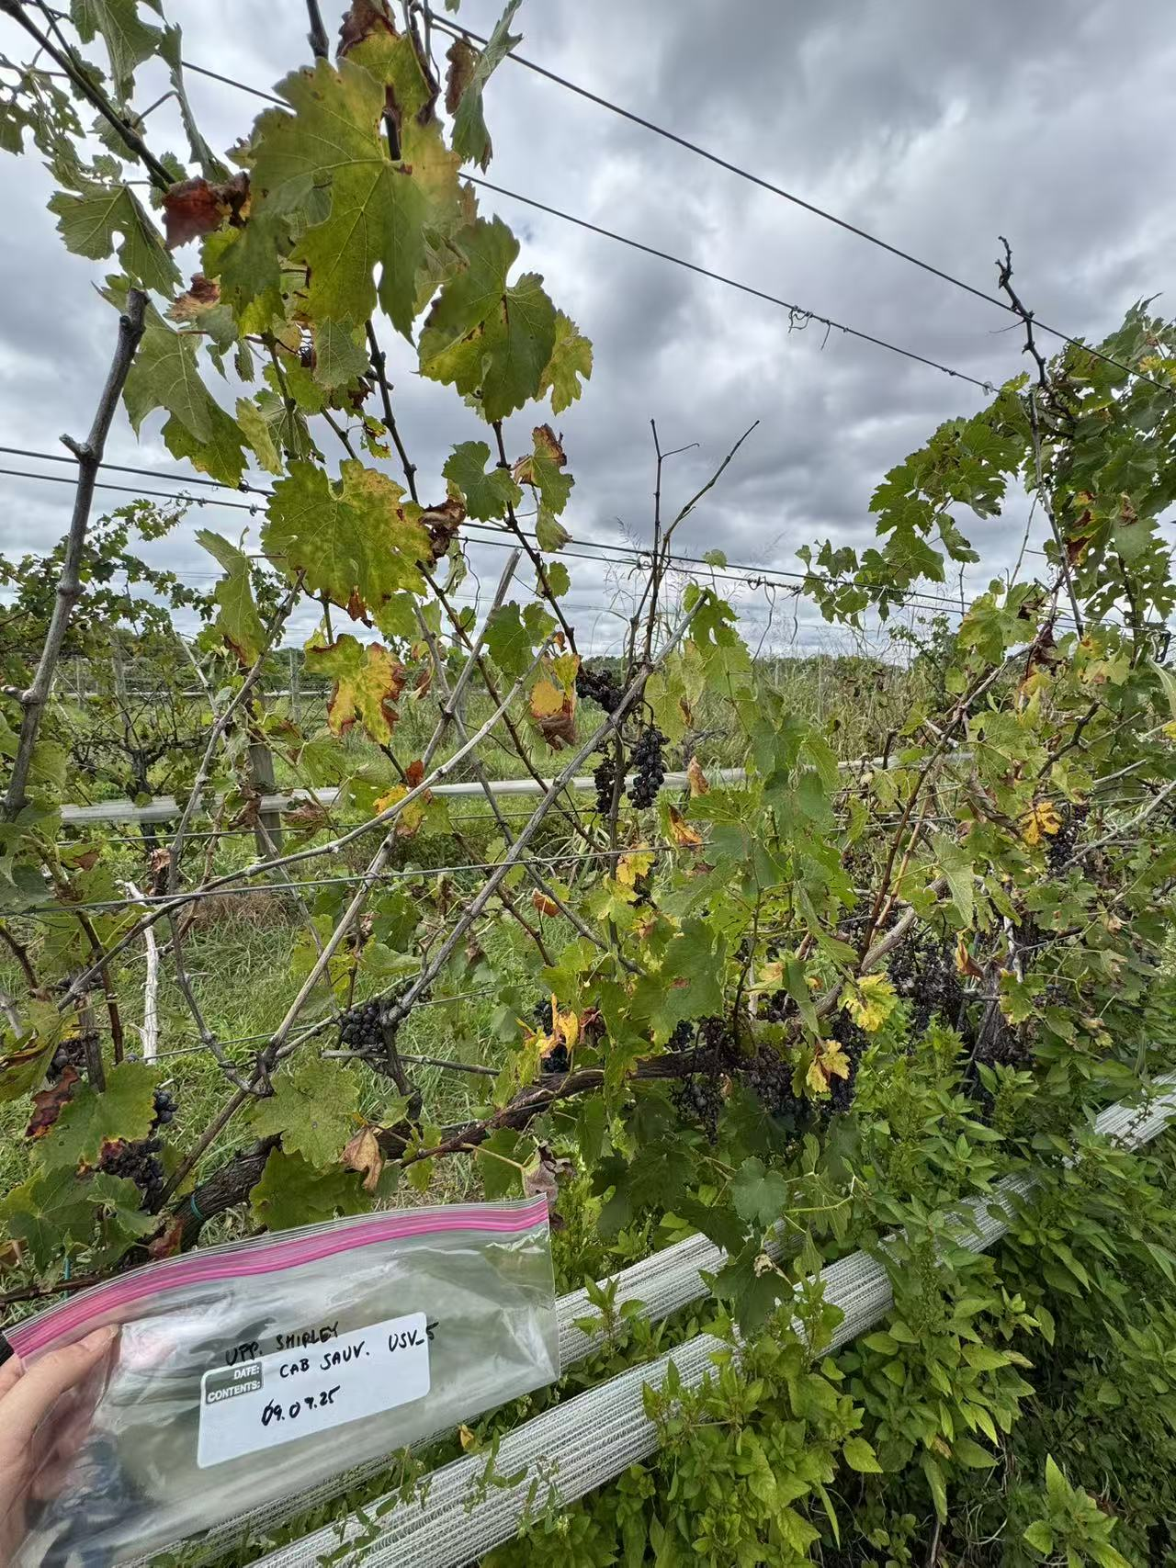
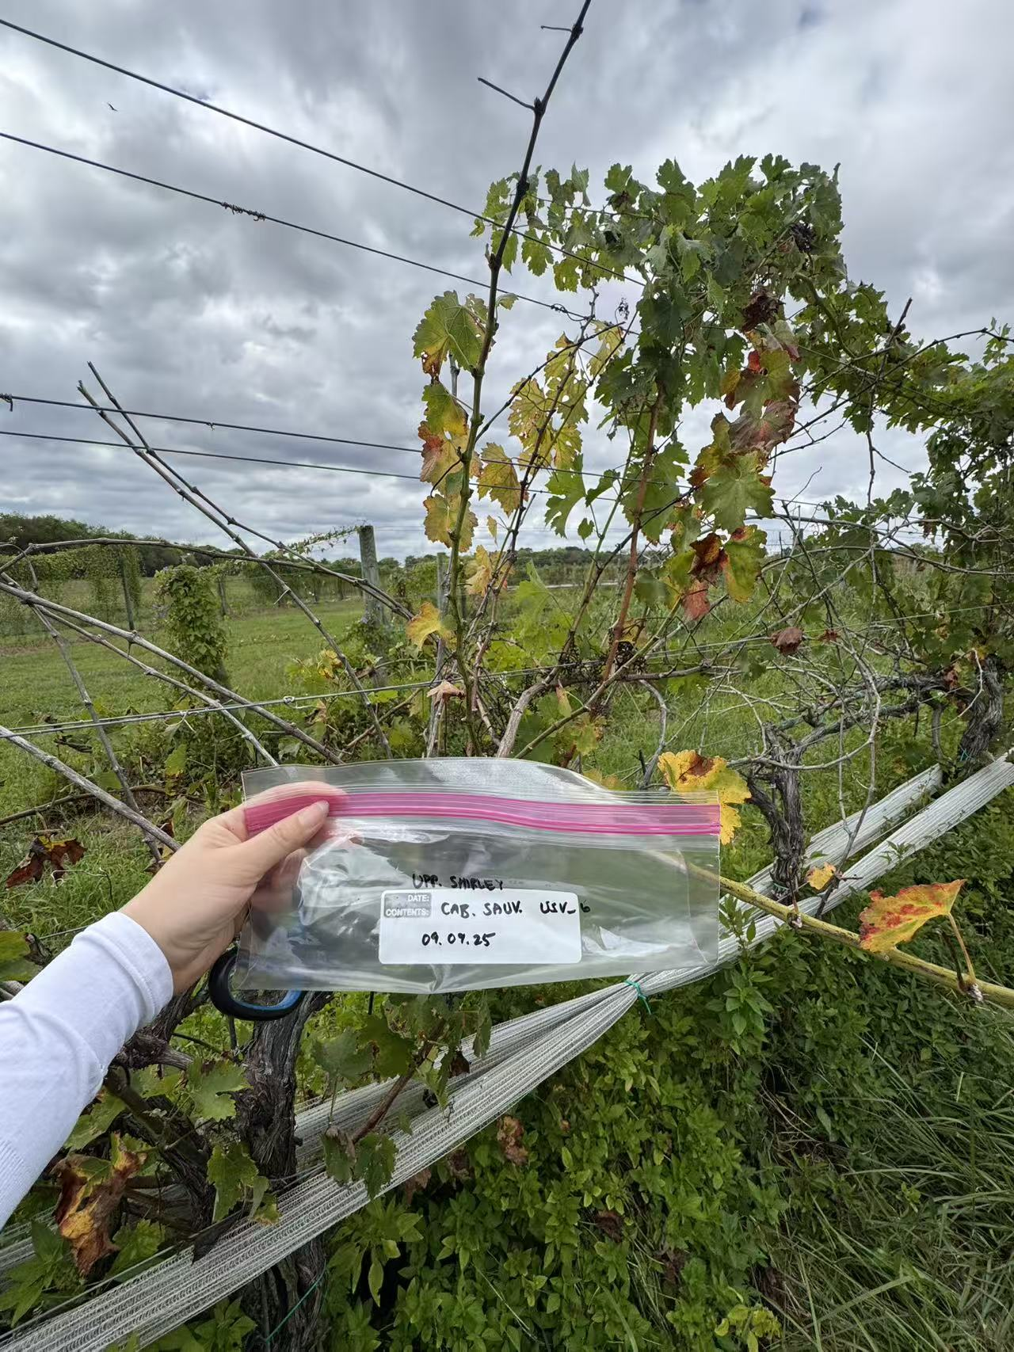
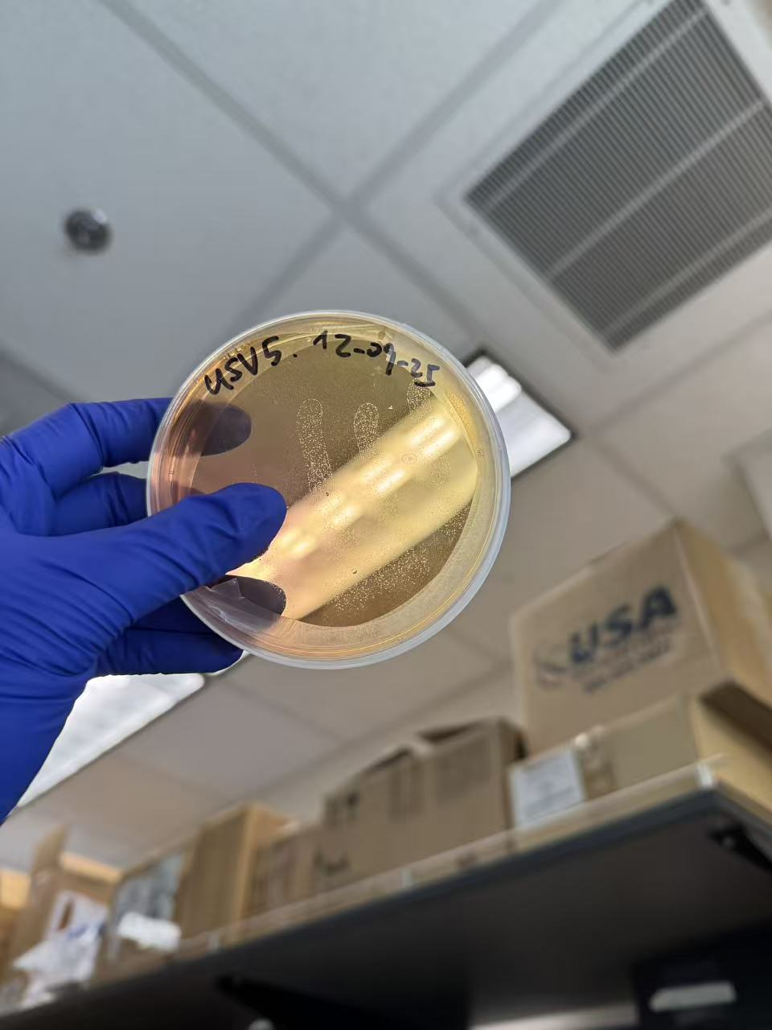
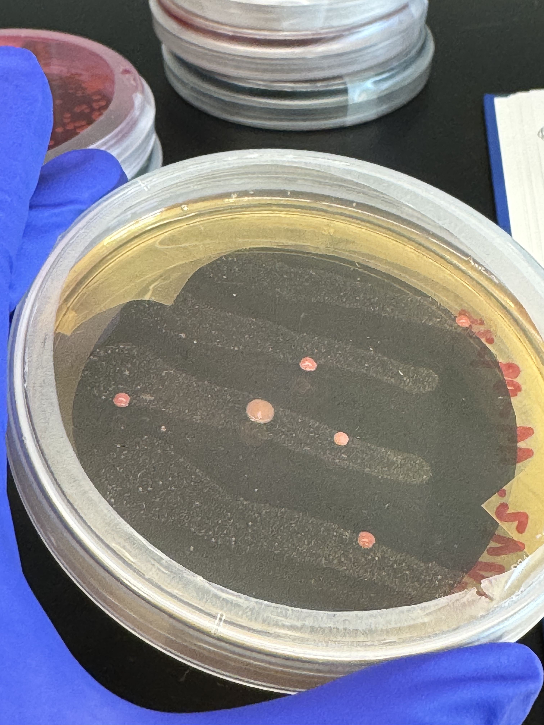
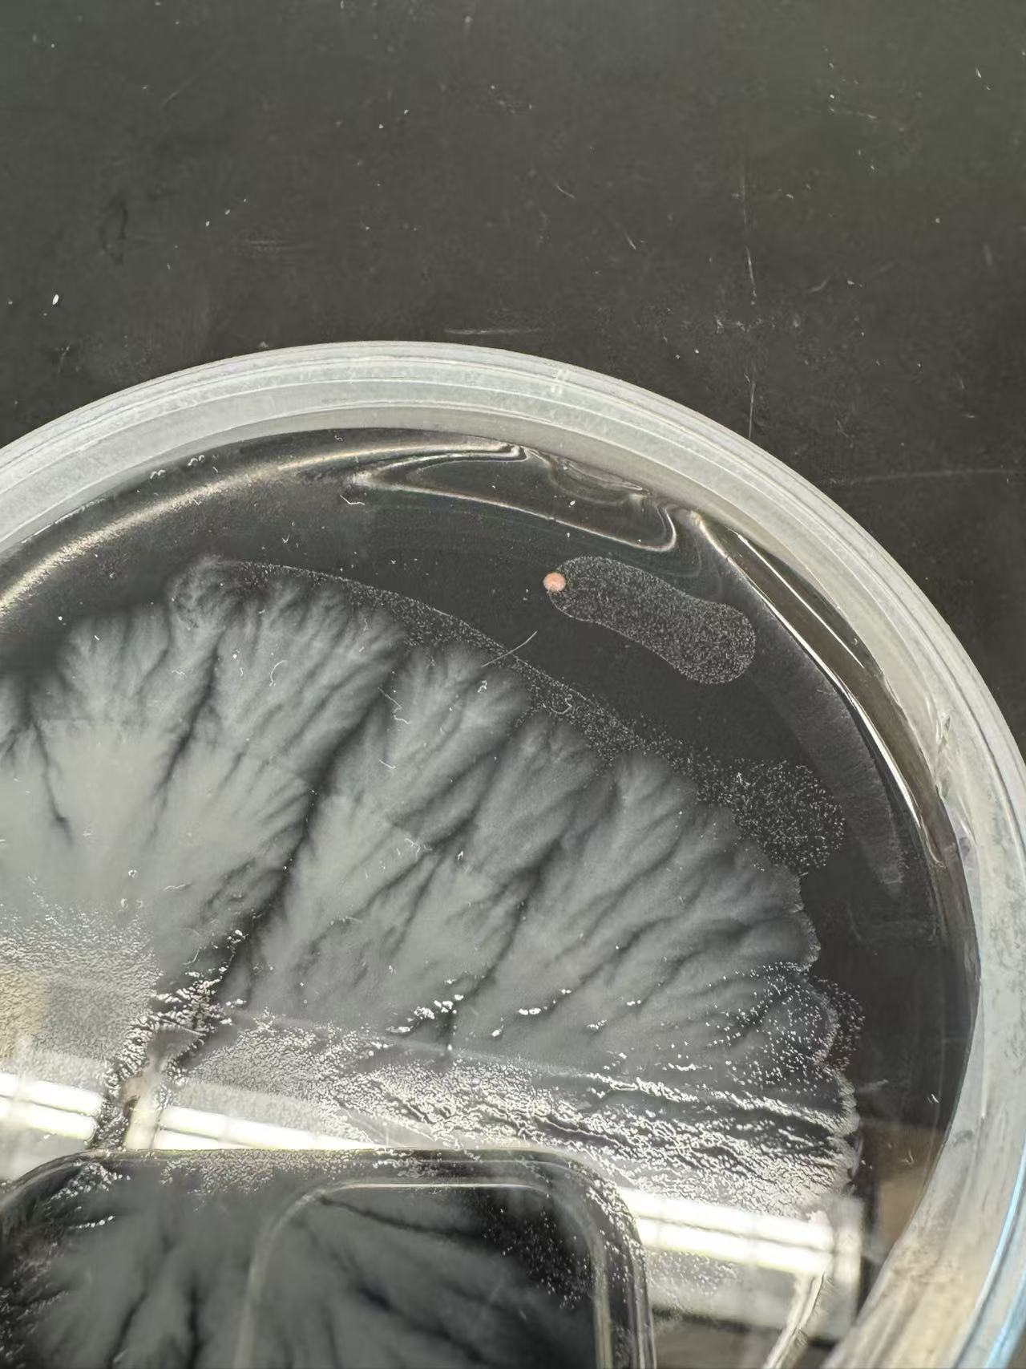
Isolated samples (Upper Shirely Vineyards)
PWG
BCYE
Cabernet Sauvignon

Slide 5
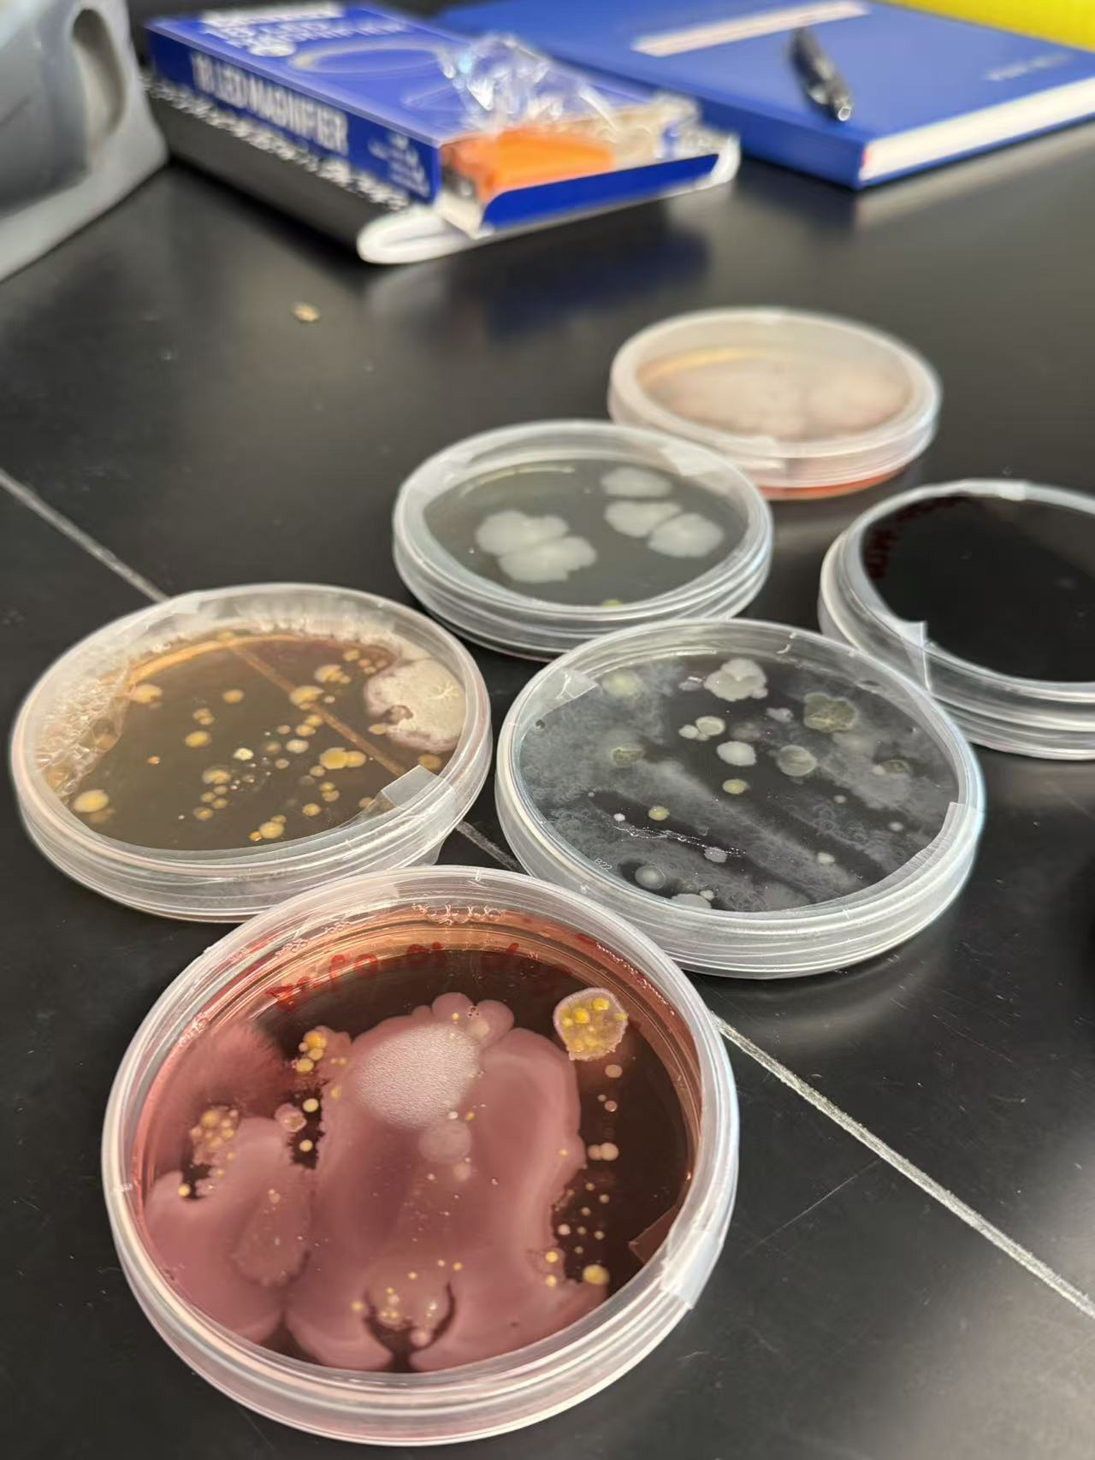
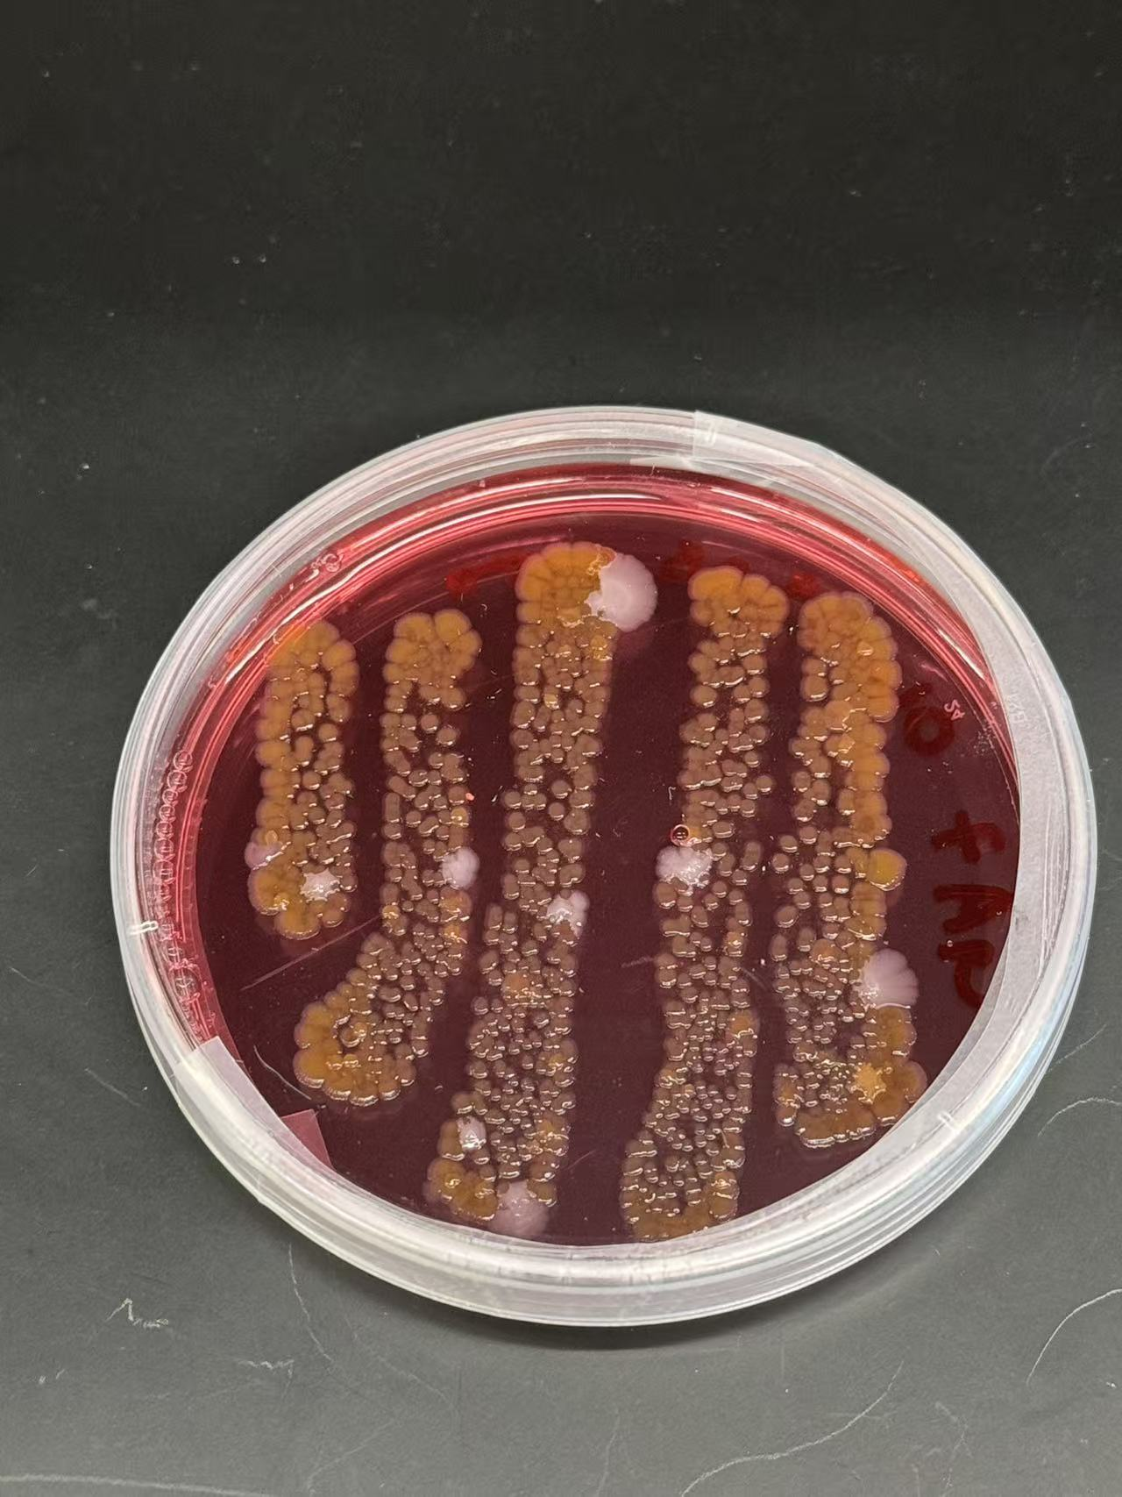
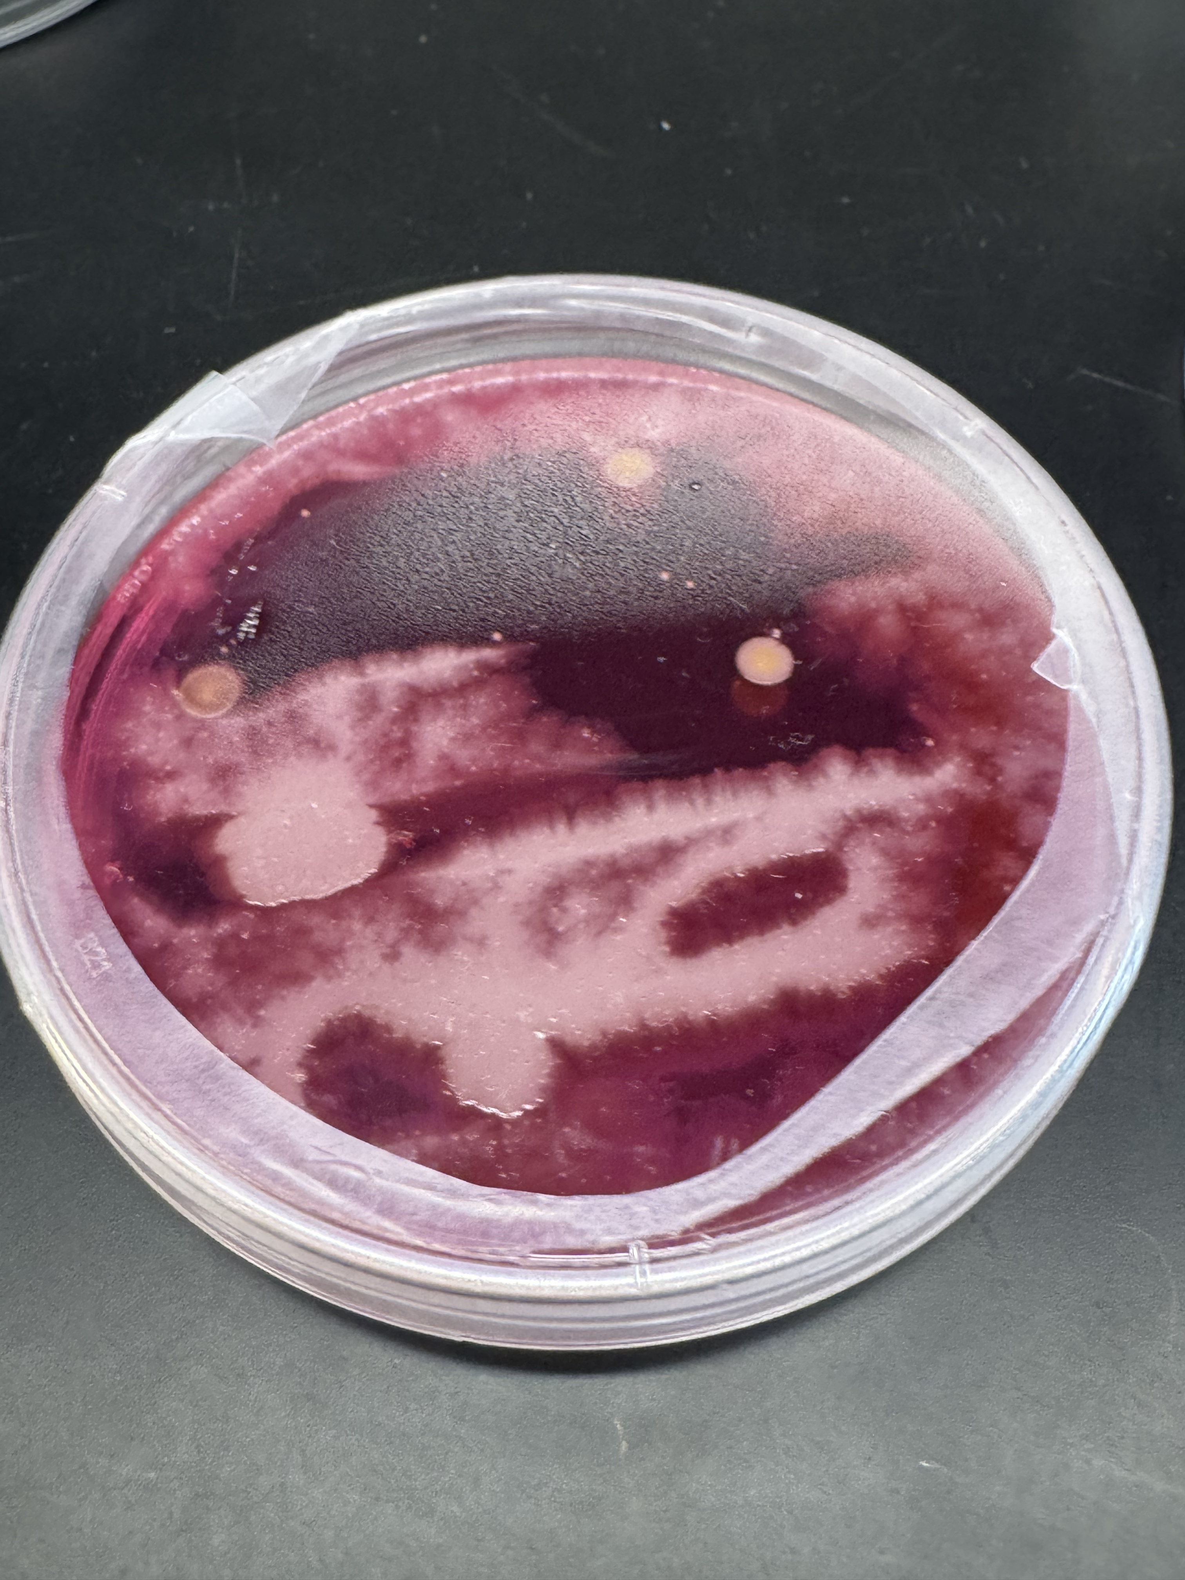
Challenges
Contamination growth and overgrowth of non-target bacteria on the plates.
Failure to isolate Xylella fastidiosa strains from tree samples.

Slide 6
Current Workflow...
🧫 1. Whole-genome sequencing (WGS) → DNA extraction from pure cultures → Long-term storage
🧬 2. Metagenomic sequencing → DNA extraction from plant samples → Selection of qPCR-positive samples (geographically representative) → Shotgun sequencing
🌳 3. Isolation optimization (trees) → Based on EPPO protocol PM7/24 (5), Appendix 15 §3

Slide 7
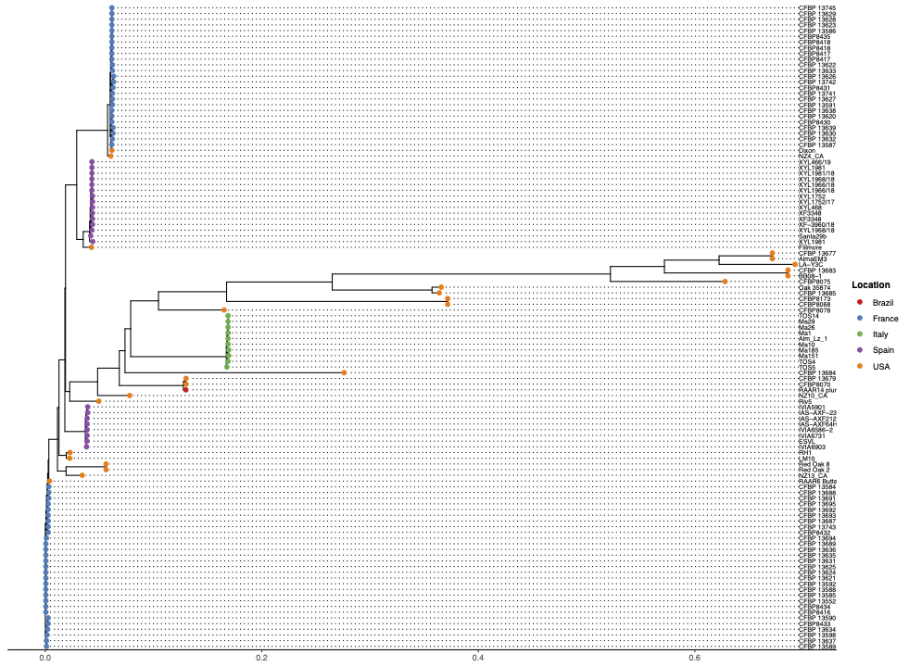
Xylella fastidiosa subsp. multiplex — SNP Phylogeny
Distinct geographic clustering observed among isolates.
USA: high genetic diversity; occupy basal branches → likely ancestral source.
Europe: form well-supported monophyletic clades, suggesting introduction bottlenecks.
Brazil: form a separate cluster, indicating a unique evolutionary path.
Notes:
Clear geographic clustering of isolates
USA strains → high genetic diversity, basal positions (ancestral origin)
Europe (France, Italy, Spain) → distinct clades, limited diversity (bottlenecks)
France–Spain closely related → possible shared introduction
Italy distinct → likely independent introduction
Brazil separate cluster → unique evolutionary path

Slide 8
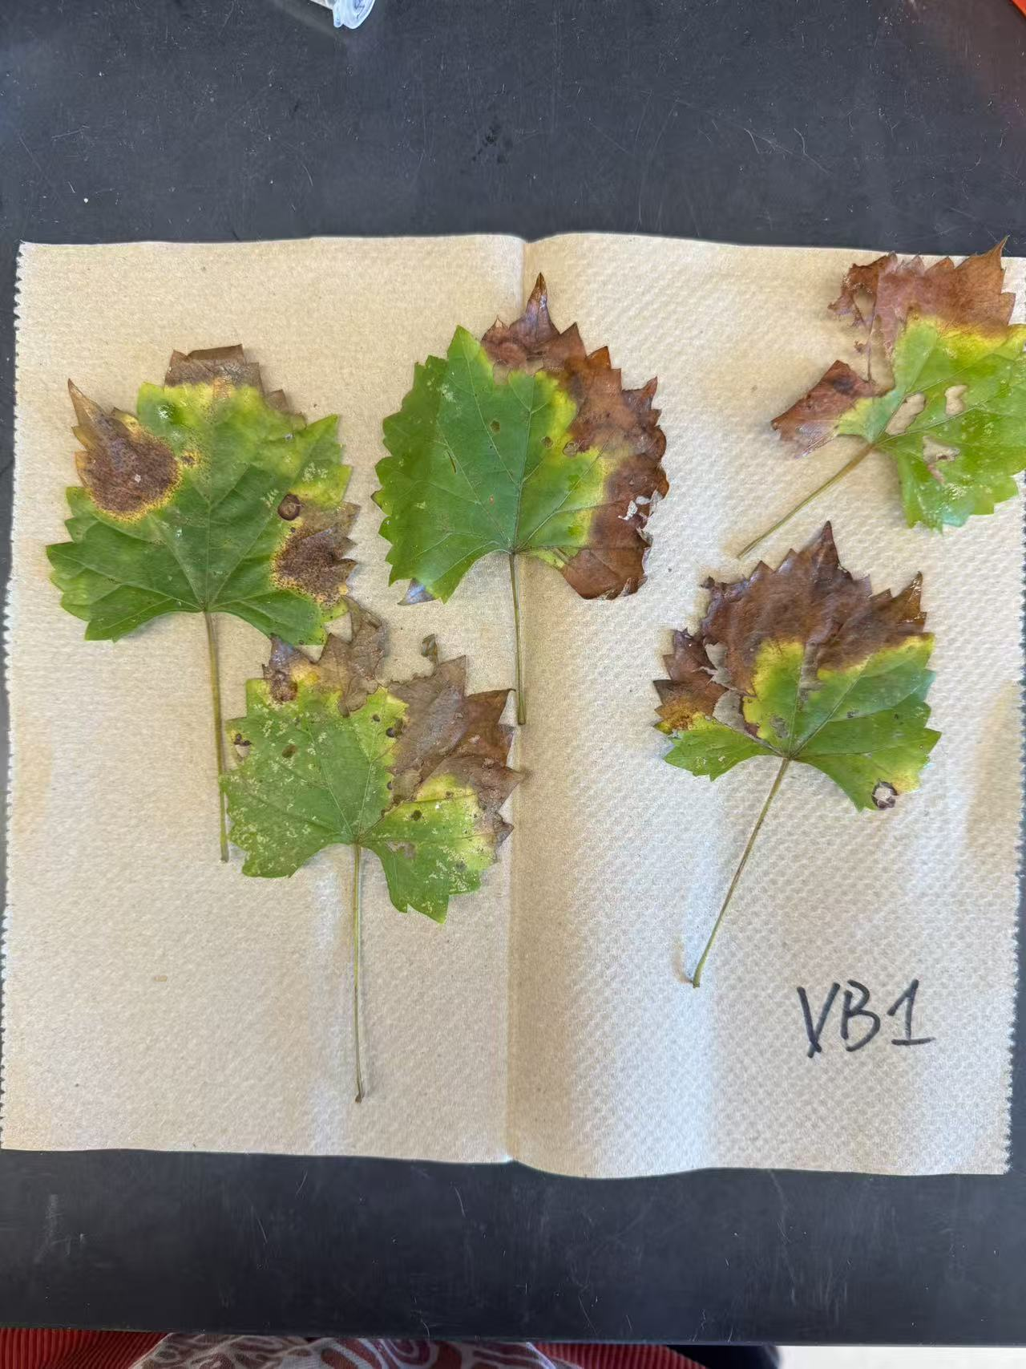
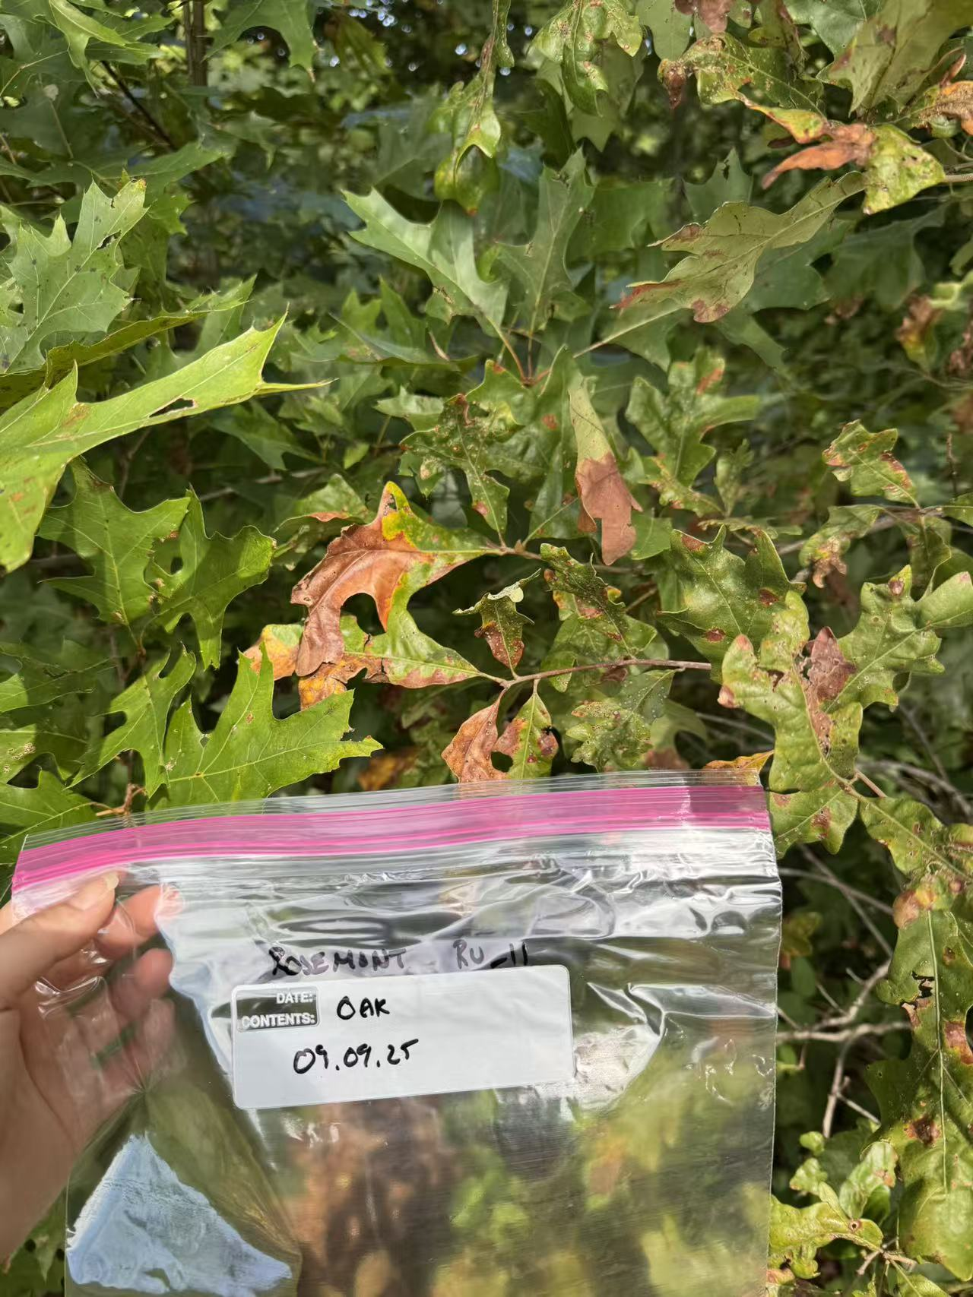
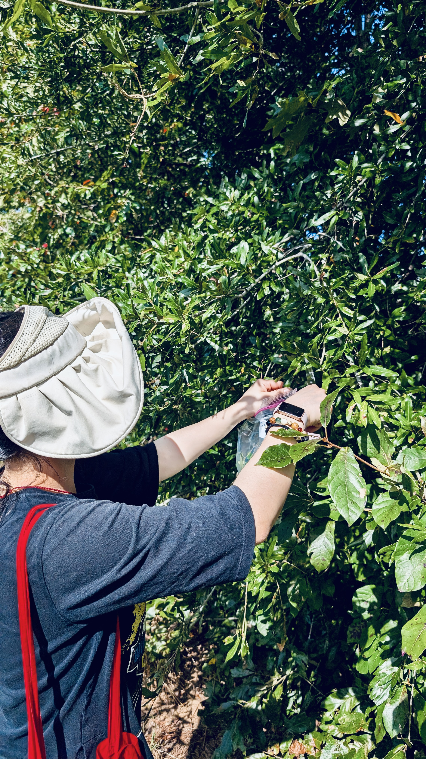
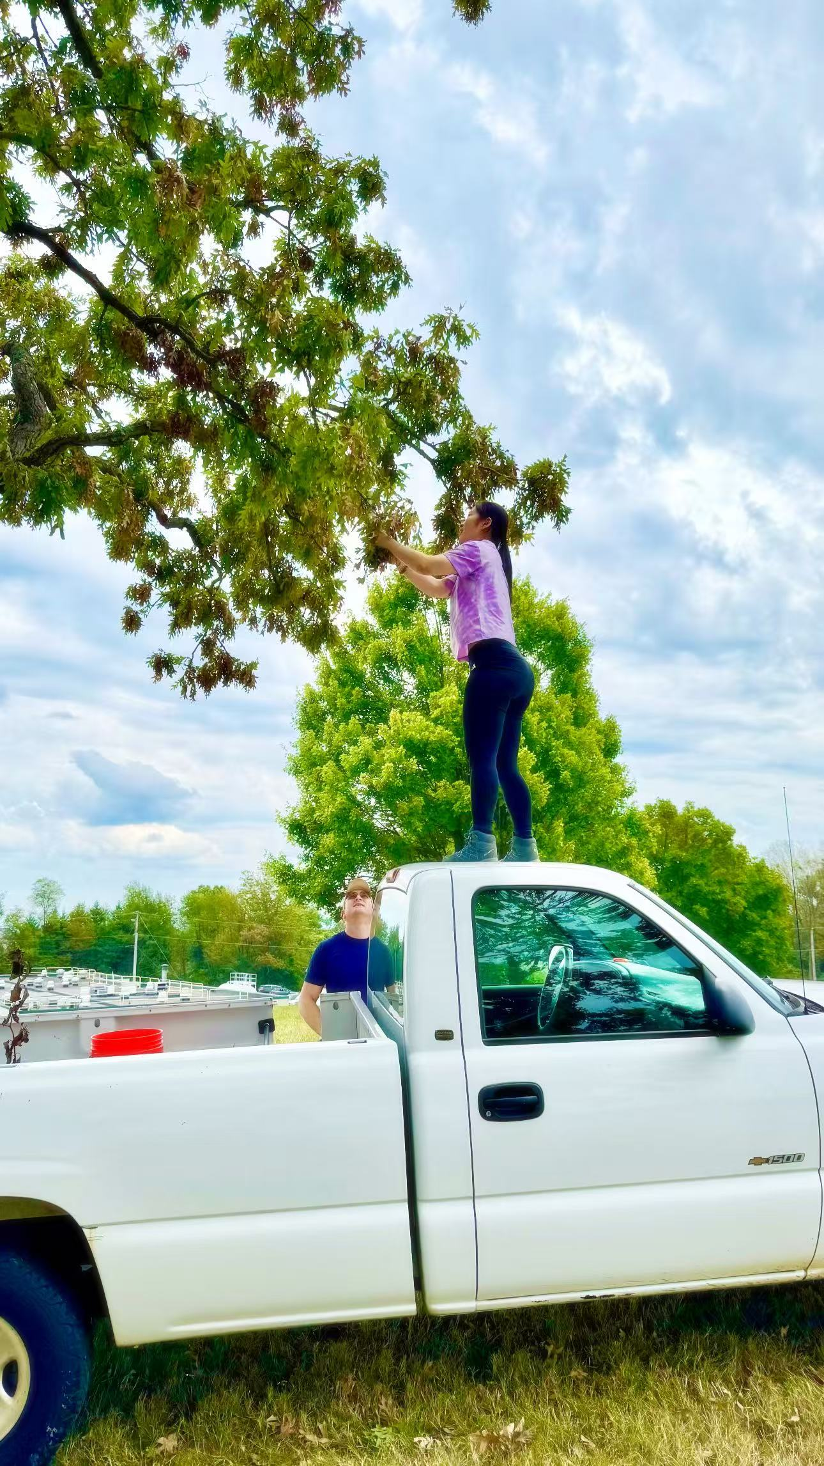
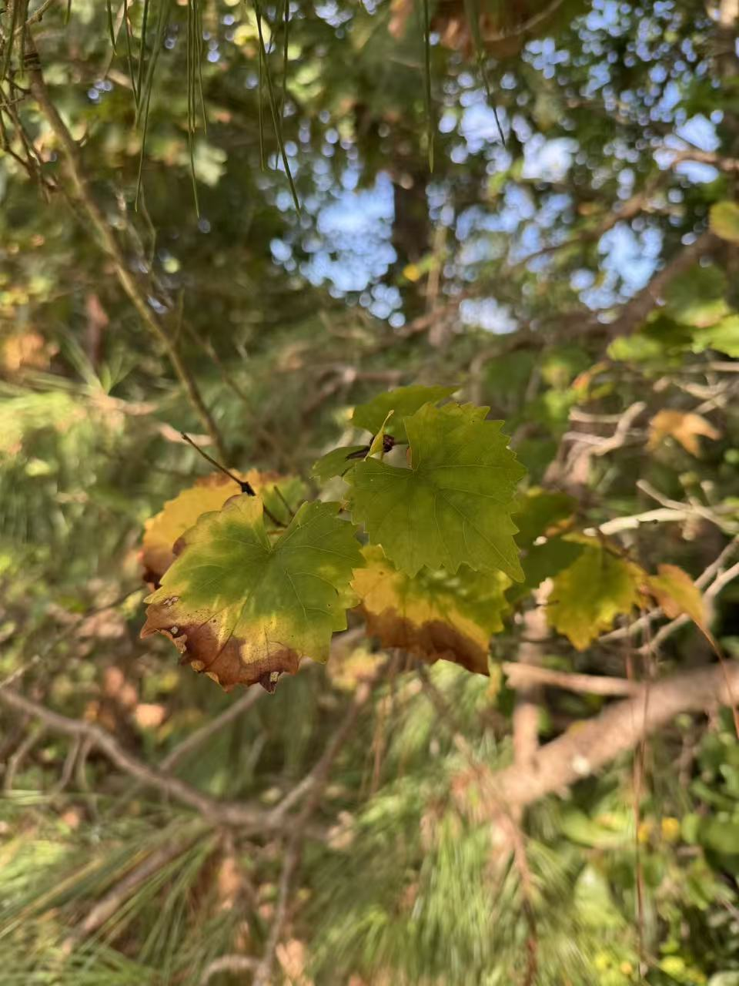
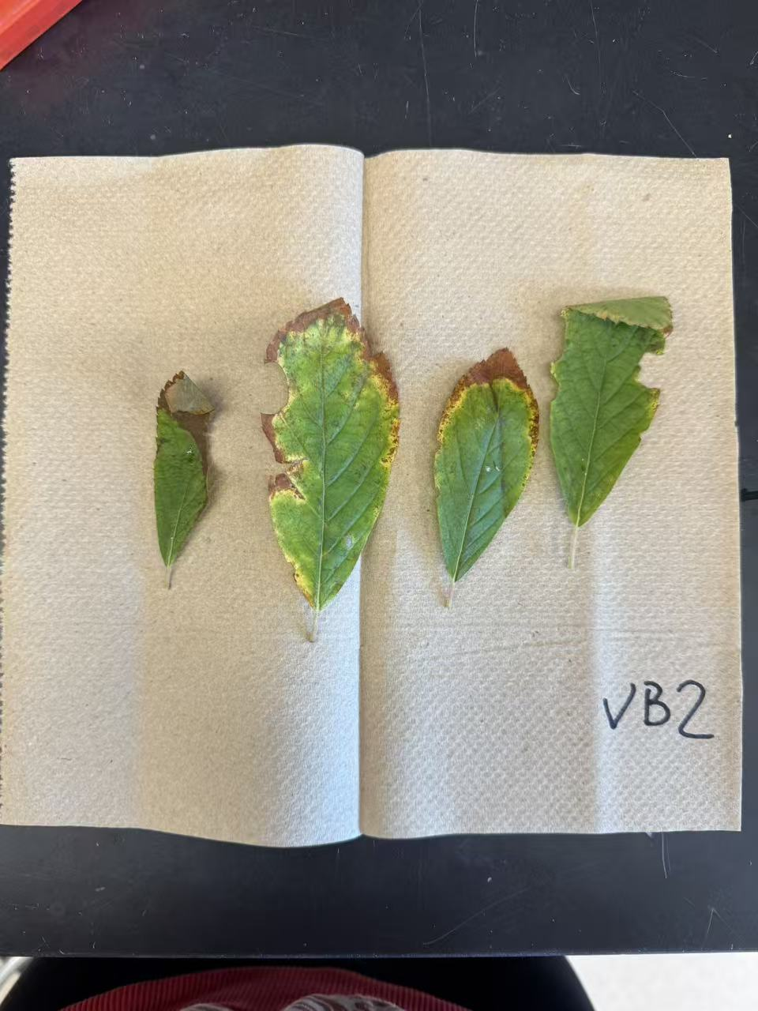
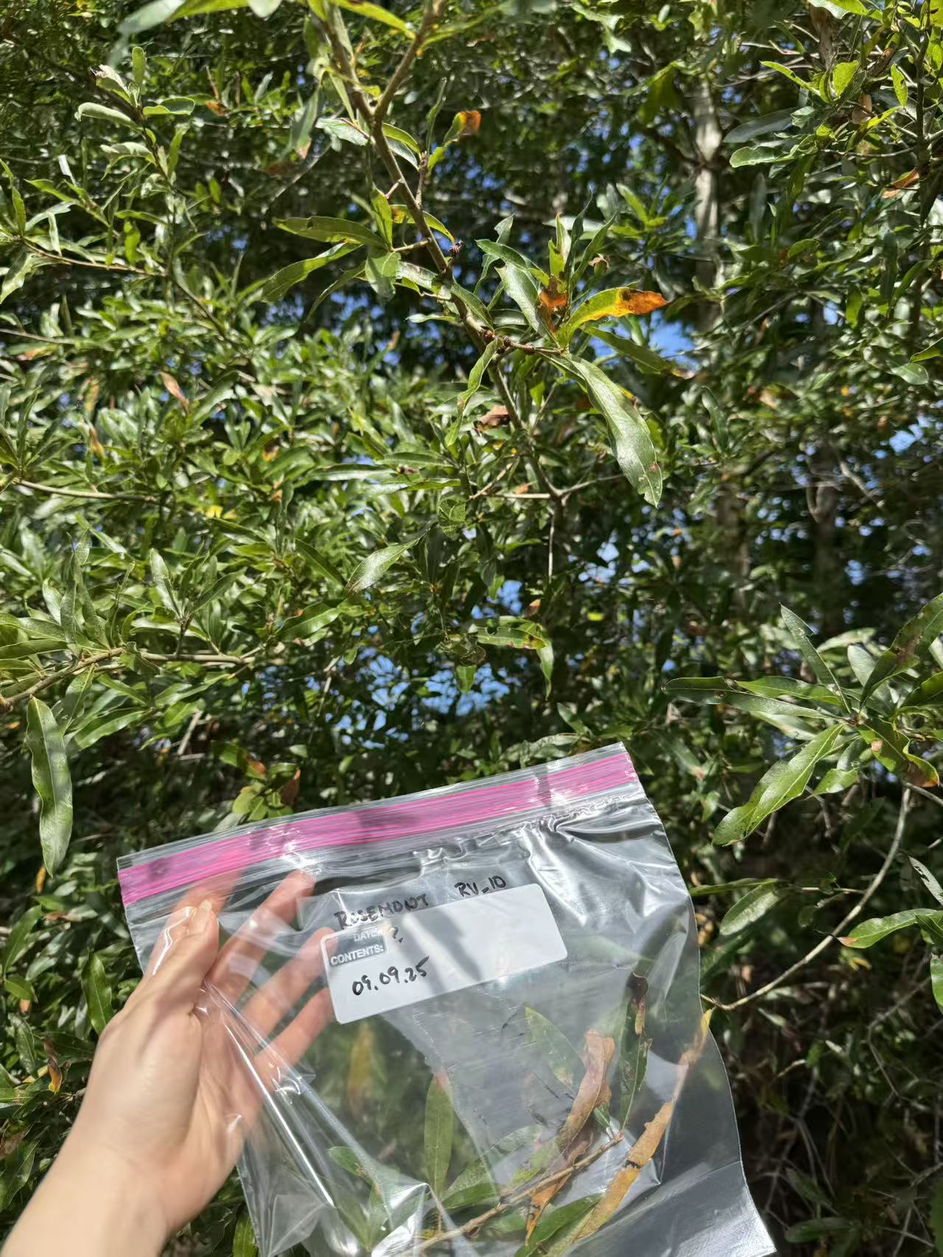
Some wild samples…

